Slide 1

The Common Rhythms of the Arabic-Oriental Music
Dr. Gilbert Yammine
www.gilbertyammine.com

Slide 2
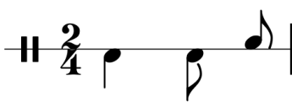

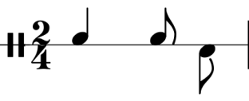
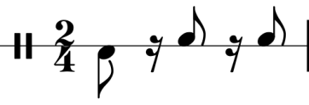
Ayoub
Karatchy
Malfouf

Slide 3



Maksoum
Saidi
Chiftetelli

Slide 4



Zaffa
Wehda
Sudasi

Slide 5



Ugruk
Dawr Hindi
Semai Thakil

